Slide 1

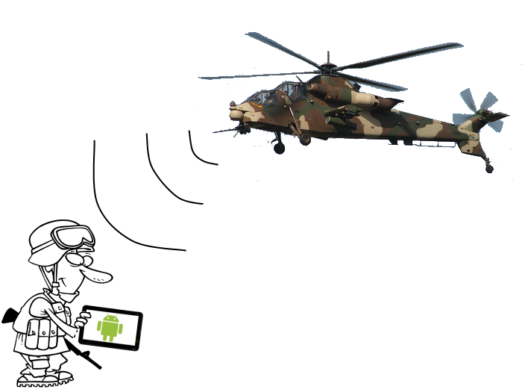
Raytheon Senior Design Project Android Based Situational Awareness: Moving Map
Lessons Learned
May 8, 2013

Slide 2
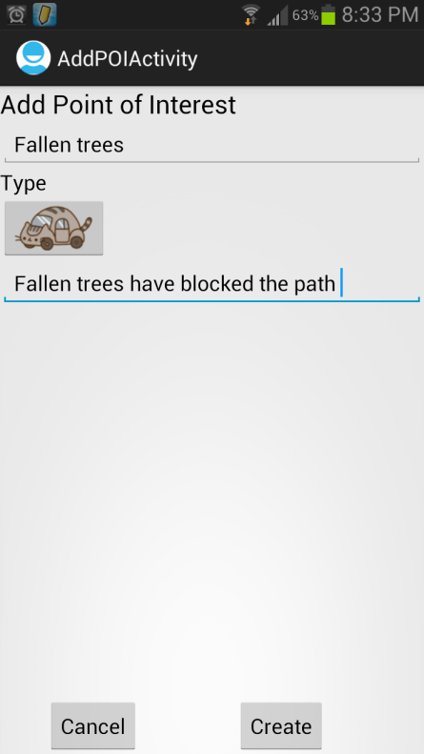
Project Overview
Background: There are no current Raytheon non-web based mapping applications on an Android device.
CONOPS: (Concept of Operations) The application is intended for soldiers, law enforcement officers, or other personnel without access to the Internet. The application will be compatible with Android devices.
Key Assumptions:
Application can smoothly synchronize with support server
Android device can cache enough map data to allow for smooth map transitions
Buyoff Criteria:
Final Release Demonstration for Raytheon Management
Successful completion of all university project requirements
Deliverables:
Program Documentation (Schedule, etc.)
Requirements/Architecture
System Design
Source Code/Executables
Demonstrations

Slide 3
Scenario
Rescue team assigned to natural disaster relief
No access to external Internet
Need access to maps
Need ability to mark downed trees, power lines, rescue locations, etc.
Need ability to share data to other devices on the network

Slide 4
Lessons Learned

Slide 5
Keep Discussions Relevant
Limited time with key stakeholders
Keep focused on goals
Notes:
Try to learn what they want not what you want, what they need not what you need, still be friendly

Slide 6
Choose Wisely
Interesting Project Area
Well defined scope
Manage expectations

Slide 7
Utilize Process
Commit to a demo schedule
Keep deadlines
Stick to a task assignment system
Use peer evaluations
Commit to team work time

Slide 8
Communication
Maintain high visibility to all stakeholders
Admit lack of progress
Avoid Specializations
GUI person
Backend person

Slide 9
Questions

